Slide 1
GIT

Slide 2

Session Plan
About Git
Version Control Systems
Distributed VCS (GIT)
Local Git areas
Git workflow
Creating Git Repo
Git commands
Branching and Merging
Interaction with Remote Repo
GitHub

Slide 3

About Git
Created by Linus Torvalds,
creator of Linux, in 2005
– Came out of Linux development community
– Designed to do version control on Linux kernel
• Goals of Git:
– Speed
– Support for non-linear development
(thousands of parallel branches)
– Fully distributed
(Committing code does not require access to a central server)
– Able to handle large projects efficiently
(speed and data size) (13,5 million lines of code)

Slide 4
References
The standard one: http://git-scm.com
Free on-line book: http://git-scm.com/book
Git tutorial: http://schacon.github.com/git/gittutorial.html
From StackExchange: http://stackoverflow.com/questions/315911/git-for-beginners-the-definitive-practical-guide#323764
From github- https://help.github.com/
At command line: (where verb = config, add, commit, etc.)
– git help verb

Slide 5
Version Control Systems
Version control (or revision control, or source control) is all about managing multiple versions of documents, programs, web sites, etc.
Almost all “real” projects use some kind of version control
Essential for team projects, but also very useful for individual projects
Some well-known version control systems are CVS, Subversion, Mercurial, and Git
CVS and Subversion use a “central” repository; users “check out” files, work on them, and “check them in”
Mercurial and Git treat all repositories as equal
Distributed systems like Mercurial and Git are newer and are gradually replacing centralized systems like CVS and Subversion

Slide 6
Why Version Control?
For working by yourself:
Gives you a “time machine” for going back to earlier versions
Gives you great support for different versions (standalone, web app, etc.) of the same basic project
For working with others:
Greatly simplifies concurrent work, merging changes

Slide 7
Centralized VCS
In Subversion, CVS, Perforce, etc. A central server repository (repo) holds the "official copy" of the code – the server maintains the sole version history of the repo
You make "checkouts" of it to your local copy
– you make local modifications
– your changes are not versioned
When you're done, you "check in" back to the server
– your check-in increments the repo's version

Slide 8


Traditional Centralized VC model (CVS, Subversion)
Central Repository
Checkouts & Updates
Commits & Adds

Slide 9
Distributed VCS (Git)
In git, mercurial, etc., you don't "checkout" from a central repo
– you "clone" it and "pull" changes from it
Your local repo is a complete copy of everything on the remote server
- yours is "just as good" as theirs
Many operations are local:
- check in/out from local repo
- commit changes to local repo
- local repo keeps version history
When you’re ready, you can “push” changes back to server.

Slide 10

Distributed version control system (git)
Local
Local
Remote repository
Local
Local
Pulls & Clones
Pushes
Commits & Adds
Notes:
Everything is a branch
Every clone is always a backup
Committing is fast
Working offline also can work

Slide 11
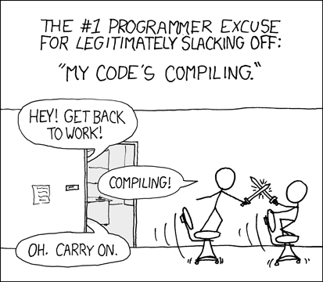
Advantages
Changing branches can be done offline
Other revisions of a file can be obtained
Changes can be commited offline
Merging and Diff can be done offline
”Repo server is down”
Server’s dead

Slide 12
Multiple Versions
Initial commit
Second commit
Third commit
Bob gets a copy
Fourth commit
Bob’s commit
Merge

Slide 13
Local Git areas
In your local copy on git,
files can be:
– In your local repo
(committed)
– Checked out and modified,
but not yet committed
(working copy)
– Or, in-between, in a "staging" area
- Staged files are ready to be committed.
- A commit saves a snapshot of all staged state.
Unmodified/modified Staged Committed
Files Files Files

Slide 14
Basic GIT Workflow
Modify files in your working directory.
• Stage files, adding snapshots of them to your staging area.
• Commit, which takes the files in the staging area and stores
that snapshot permanently to your Git directory

Slide 15
Initial GIT Configuration
Set the name and email for Git to use when you commit:
– git config --global user.name "Bugs Bunny”
– git config --global user.email bugs@gmail.com
– You can call git config –list to verify these are set.

Slide 16
Creating a GIT Repo
Two common scenarios: (only do one of these)
To create a new local Git repo in your current directory:
– git init
• This will create a .git directory in your current directory.
• Then you can commit files in that directory into the repo.
– git add filename
– git commit –m "commit message“
• To clone a remote repo to your current directory:
– git clone url localDirectoryName
• This will create the given local directory, containing a working copy of
the files from the repo, and a .git directory (used to hold the
staging area and your actual local repo)

Slide 17
GIT Commands
command | description
git clone url [dir] | copy a Git repository so you can add to it
git add file | adds file contents to the staging area
git commit | records a snapshot of the staging area
git status | view the status of your files in the working directory and staging area
git diff | shows diff of what is staged and what is modified but unstaged
git help [command] | get help info about a particular command
git pull | fetch from a remote repo and try to merge into the current branch
git push | push your new branches and data to a remote repository
others: init, reset, branch, checkout, merge, log, tag

Slide 18
Add and Commit a file
The first time we ask a file to be tracked, and every time
before we commit a file, we must add it to the staging area:
– git add Hello.java Goodbye.java
• Takes a snapshot of these files, adds them to the staging area.
• In older VCS, "add" means "start tracking this file." In Git, "add"
means "add to staging area" so it will be part of the next commit.
• To move staged changes into the repo, we commit:
– git commit –m "Fixing bug #22"
• To undo changes on a file before you have committed it:
– git reset HEAD – filename (unstages the file)
– git checkout -- filename (undoes your changes)
– All these commands are acting on your local version of repo.

Slide 19
Viewing and Undoing the changes
To view status of files in working directory and staging area:
– git status or git status –s (short version)
• To see what is modified but unstaged:
– git diff
• To see a list of staged changes:
– git diff --cached
• To see a log of all changes in your local repo:
– git log or git log --oneline (shorter version)
1677b2d Edited first line of readme
258efa7 Added line to readme
0e52da7 Initial commit
- git log -5 (to show only the 5 most recent updates), etc.

Slide 20
Branching and Merging
Git uses branching heavily to switch between multiple tasks.
• To create a new local branch:
– git branch name
• To list all local branches: (* = current branch)
– git branch
• To switch to a given local branch:
– git checkout branchname
Creates and checkouts to a branch called <name>
- git checkout -b <name>
To merge changes from a branch into the local master:
– git checkout master
– git merge branchname

Slide 21
Merge Conflicts
The conflicting file will contain <<< and >>> sections to
indicate where Git was unable to resolve a conflict:
Find all such sections, and edit them to the proper state
(whichever of the two versions is newer / better / more correct).
<<<<<<< HEAD:index.html
<div id="footer">todo: message here</div>
=======
<div id="footer">
thanks for visiting our site
</div>
>>>>>>> SpecialBranch:index.html
branch 1’s version
branch 2’s version

Slide 22
Rebase
Changes the "starting point" of a branch
Can be used in feature branches when the "development branch" changes drastically and it affects the feature branches
Usage: $ git rebase <branch> sets the starting point of the current branch to <branch>

Slide 23
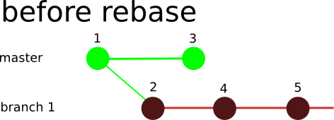
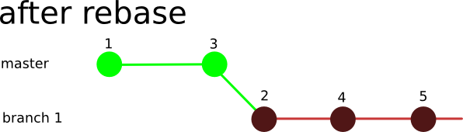

Slide 24
Interaction w/ remote repo
Push your local changes to the remote repo.
Pull from remote repo to get most recent changes.
– (fix conflicts if necessary, add/commit them to your local repo)
To fetch the most recent updates from the remote repo into
your local repo, and put them into your working directory:
– git pull origin master
To put your changes from your local repo in the remote repo:
– git push origin master

Slide 25
Creating a central repository
While technically any repository can be used as a central repository, it is sometimes better to create a ”bare” repo to act as a central unit
If you use a full git repository as a central repo, you will get errors
Bare repositories contain just the contents of the .git folder, and no working directory
They cannot be locally modified
Instead all changes must be pushed to them
Creation of a bare repo:
$ git init --bare

Slide 26
GitHub
GitHub.com is a site for online storage of Git repositories.
– You can create a remote repo there and push code to it.
– Many open source projects use it, such as the Linux kernel.
– You can get free space for open source projects,
or you can pay for private projects.
- Free private repos for educational use: github.com/edu
• Question: Do I always have to use GitHub to use Git?
Answer : No! You can use Git locally for your own purposes.
– Or you or someone else could set up a server to share files.
– Or you could share a repo with users on the same file system, as
long everyone has the needed file permissions).

Slide 27
Stashing commits
Stashing commits can be useful when you have made some changes in your working directory, but want to return to a ”clean working directory”
Like when you need to do a quick fix on something entirely else, but your hacking is not complete
Usage
Stashing your commits since last pull
$ git stash
Listing all stashed changes
$ git stash list
Recovering changes from stash
$ git stash pop

Slide 28

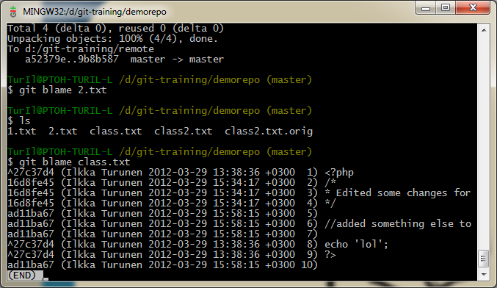
Blame it on others
blame allows you to see who has modified a file on a line by line basis
blame prints out the entire file accompanied by the name of the user who made changes to that specific file
usage example: $ git blame <filename>

Slide 29
Best practices for code collaboration
When to commit?
Source of major arguments (big changes vs small change)
Never put broken code on the master branch (test first!)
Try not to break things (don't do two weeks worth of work in one commit)
Always use a clear, concise commit message
Put more details in lines below, but always make the first line short
Describe the why; the what is clear in the change log
When making giant changes, consider branches (we'll talk about these in a few slides)
Oh, and make sure your name and email are right

